Slide 1
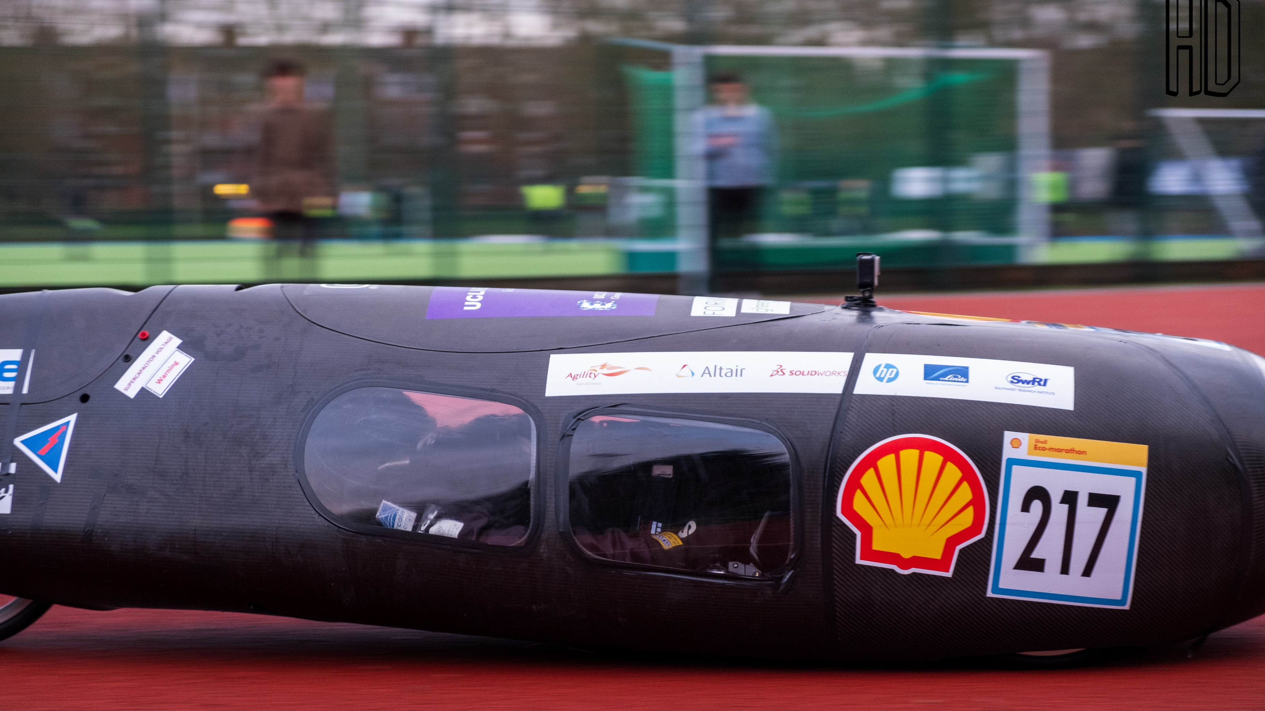
Designing a lap time simulator for the Shell Eco-Marathon
Hasha Dar

Slide 2

Physical Testing
Scope
Time
Cost

Slide 3
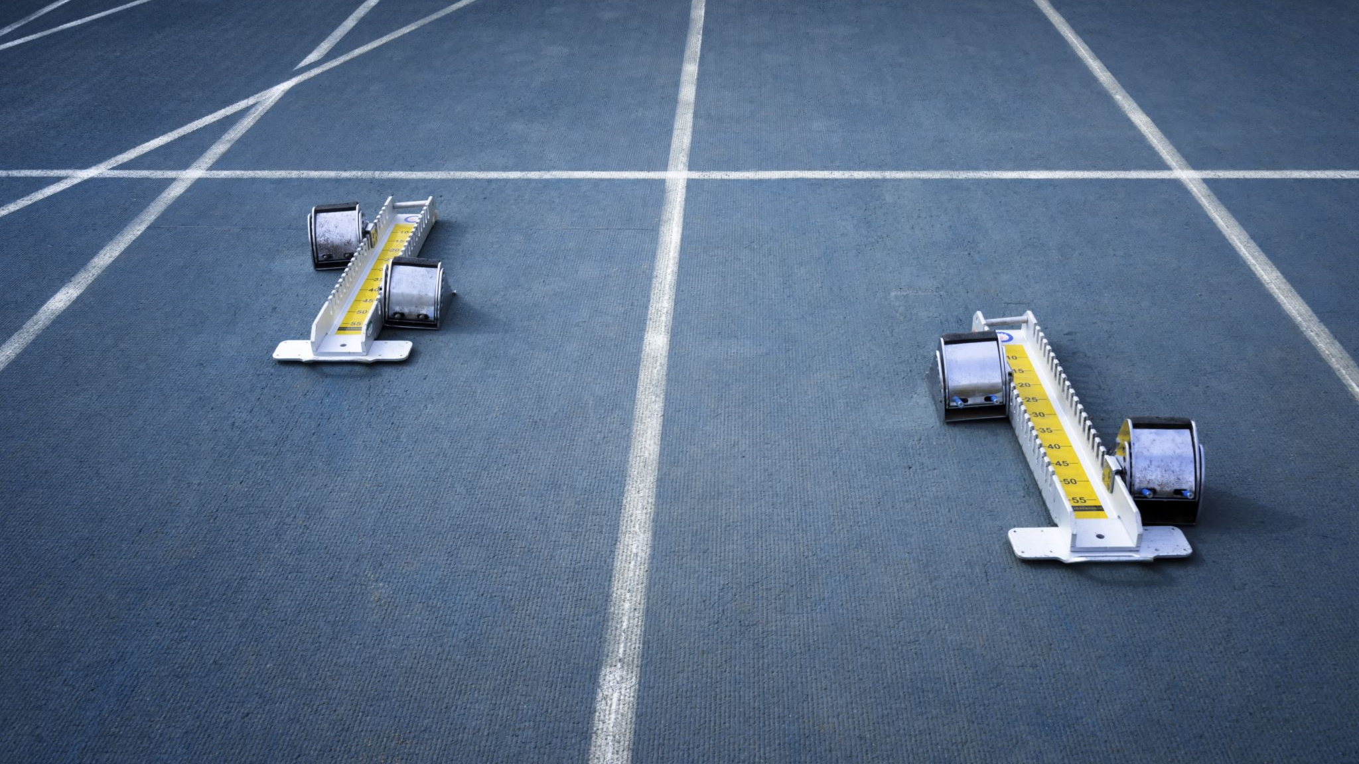
Project Aims
Processing of track and vehicle parameters
Transient simulation of vehicle around the track
Output performance data

Slide 4
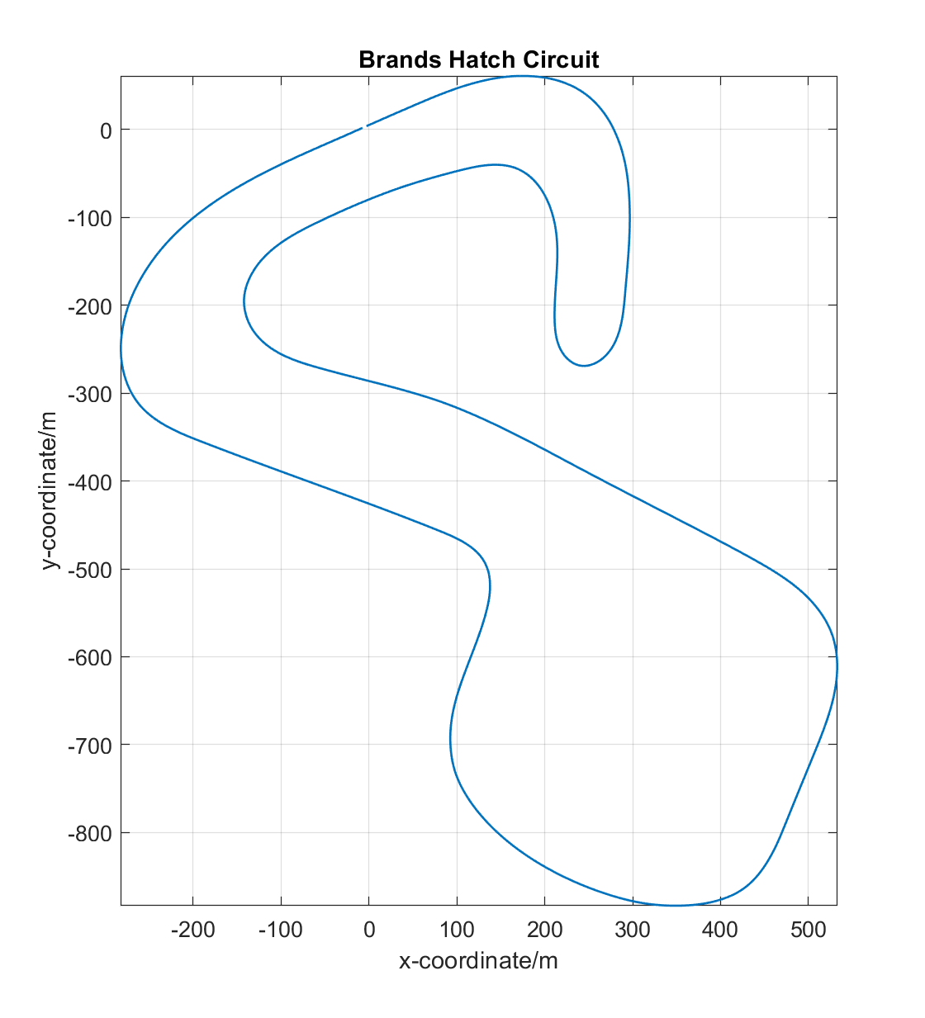
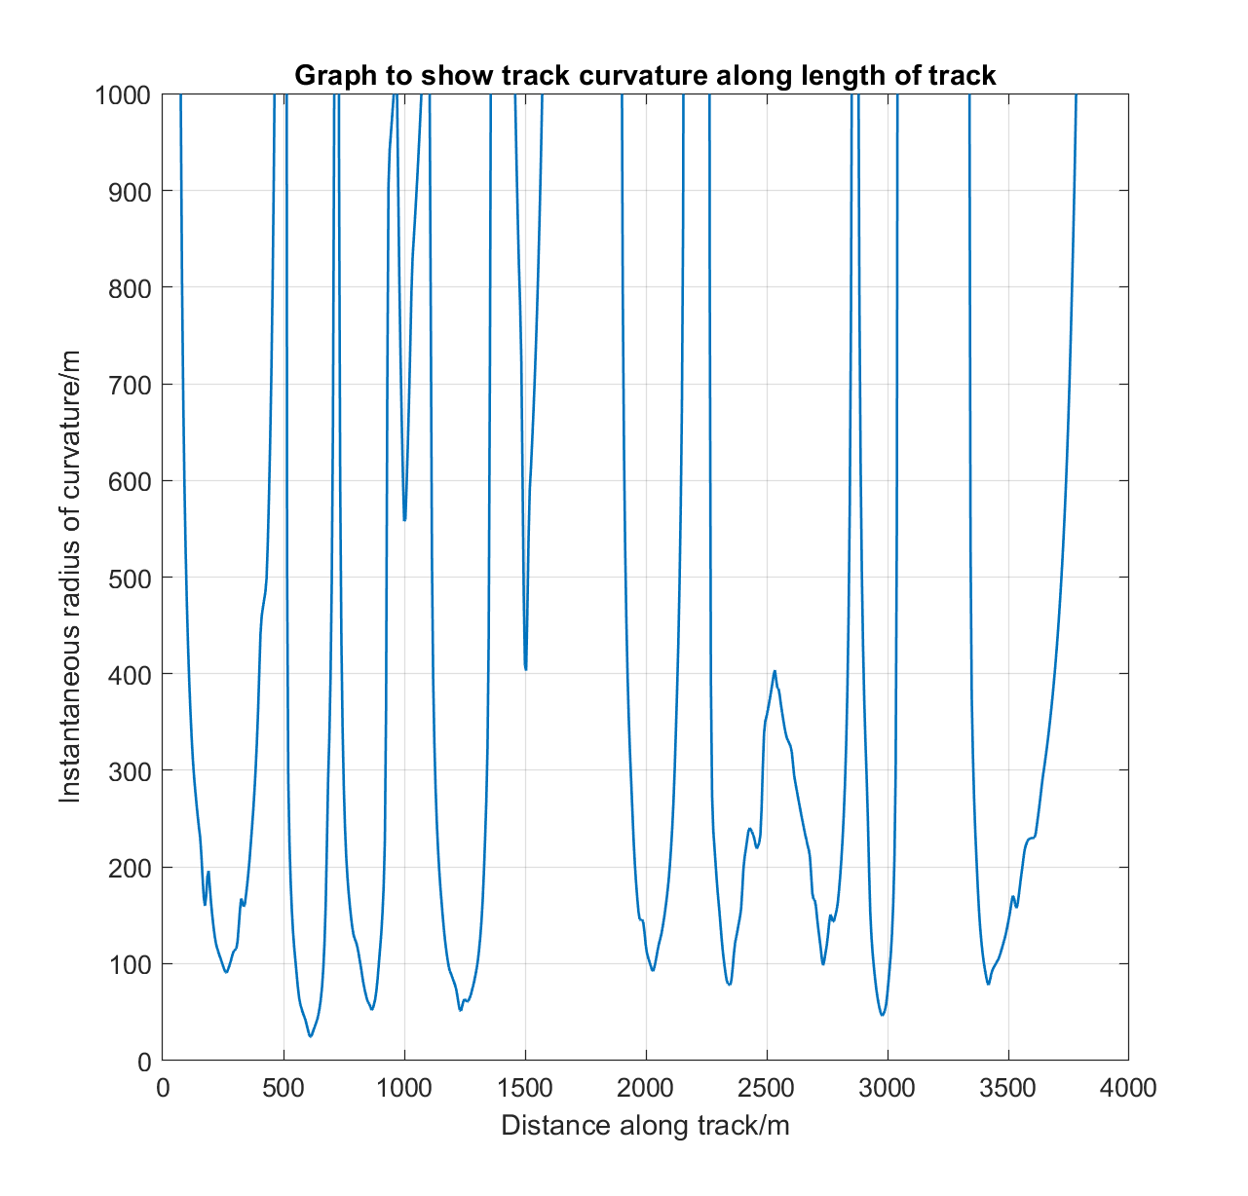
Track data
‘xyz’ coordinate data
Track curvature
Slope analysis

Slide 5
Simulink processing
Motor model
Transmission model
Body model
Output processing
Tyre model

